Slide 1

Logistic Regression
Will he? or won’t he?
Ramesh S

Slide 2
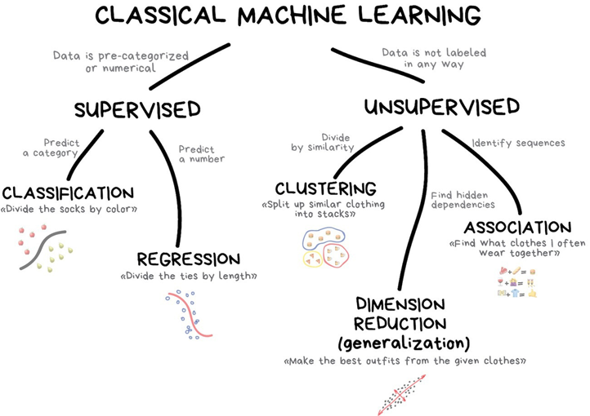
Logistic Regression

Slide 3
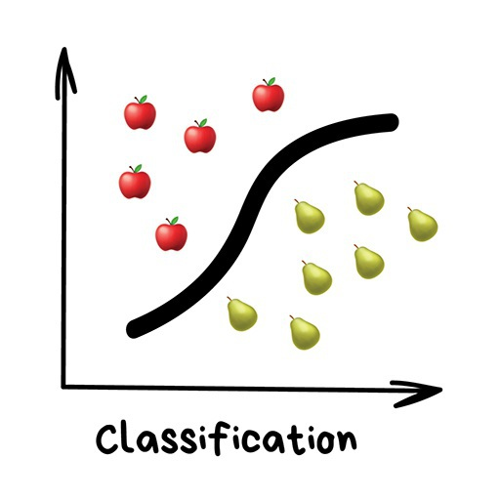
Classification
"Splits objects based at one of the attributes known beforehand. Separate socks by based on color, documents based on language, music by genre"
Today used for:
– Spam filtering
– Language detection
– A search of similar documents
– Sentiment analysis
– Recognition of handwritten characters and numbers
– Fraud detection

Slide 4
Logistic Regression
Logistic regression is generally used where the dependent variable is Binary.
That means the dependent variable can take only two possible values such as
Yes or No
Default or No Default
Living or Dead
Responder or Non Responder
Yes or No etc.
Independent factors or variables can be categorical or numerical variables.

Slide 5
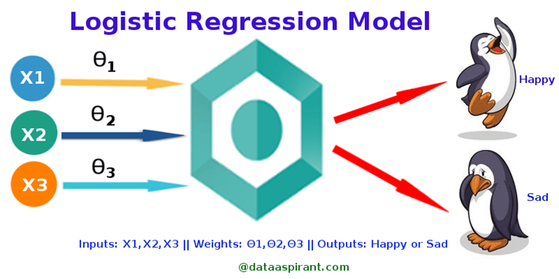

Slide 6

How Would You Choose a Trainer?
X₁ = Years of Work Experience
X₂ = Highest degree Educational Qualification
X₃ = Teaching Experience
Θ₁ = 0.3
Θ₂ = 0.3
Θ₃ = 0.4
You will base your choice on Score = X₁Θ₁ + X₂Θ₂ + X₃Θ₃

Slide 7
Logistic Regression - Models
For example, if a credit card company is going to build a model to decide whether to issue a credit card to a customer or not, it will model for whether the customer is going to “Default” or “Not Default” on this credit card.
This is called “Default Propensity Modeling” in banking lingo.

Slide 8
Logistic Regression - Models
Similarly an ecommerce company that is sending out costly advertisement / promotional offer mails to customers, will like to know whether a particular customer is likely to respond to the offer or not.
In Other words, whether a customer will be “Responder” or “Non Responder”.
This is called “Propensity to Respond Modeling”

Slide 9
Logistic Regression - Applications
Using insights generated from the logistic regression output, companies may optimize their business strategies to achieve their business goals such as
minimize expenses or losses
maximize return on investment (ROI) in marketing campaigns etc.
Other applications include:
To predict whether a customer will convert (buy or sign-up) to an offer. (will not convert: 0 / will convert: 1)
To predict and preempt customer churn. (will not drop service: 0 / will drop service: 1)
Clinical testing to predict whether a new drug will cure the average patient. (will not cure: 0 / will cure: 1)
To predict whether an email is spam (1) or (0)
Whether the tumor is malignant (1) or not (0)

Slide 10
Logistic Regression - Algorithm
The underlying algorithm of Maximum Likelihood Estimation (MLE) determines the regression coefficient for the model that accurately predicts the probability of the binary dependent variable.
The algorithm stops when the convergence criterion is met or maximum number of iterations are reached.
Since the probability of any event lies between 0 and 1 (or 0% to 100%), when we plot the probability of dependent variable by independent factors, it will demonstrate an ‘S’ shape curve.

Slide 11
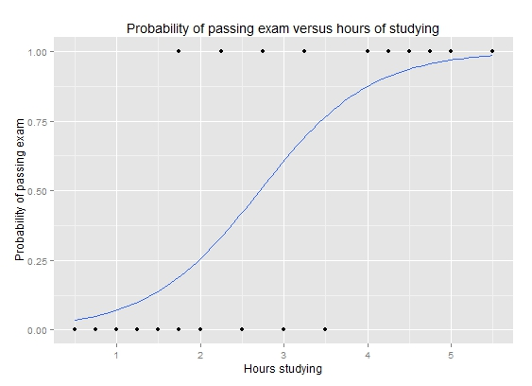

Slide 12
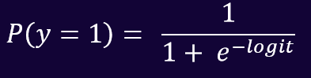
Logistic Regression - Logit Function
The logistic regression instead uses the Logistic Response Function to model how the probability of the event “Admitted” P(y=1) is affected by our variables (the exams score x):
The bigger the logit, the bigger 𝑃(𝑦=1)
The 𝑃(𝑦=1) is called Sigmoid function

Slide 13


Step Function
Suppose I start a cleaning business. I decide to charge each client based on how many hours I work for that client.
My charge structure is as follows:
Less than one hour: ₹700.00
One hour up to two hours: ₹1200.00
Two hours up to three hours: ₹2500.00
Three hours up to four hours: ₹3000.00

Slide 14
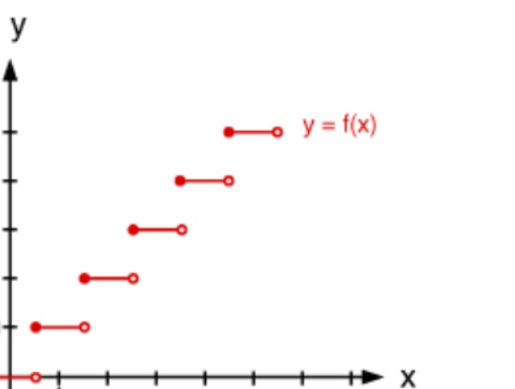
Step Function
This means that if I work anywhere from 1-59 minutes, I charge ₹700.00.
If I work anywhere from 1 hour to 1 hour and 59 minutes, I charge ₹1200.00, and so on.
We see that the amount I charge remains constant on each hour-long interval, but varies on each of those intervals, because it goes up each hour.

Slide 15
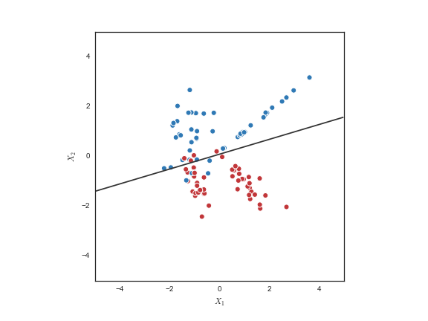
Decision Boundary
To predict which class a data belongs, a threshold can be set.
Based upon this threshold, the obtained estimated probability is classified into classes.
Say, if predicted value ≥ 0.5, then classify email as spam else as not spam.
Decision boundary can be linear or non-linear.
Polynomial order can be increased to get complex decision boundary.

Slide 16
Performance Measures
Cross Validation:
Randomly splitting the training set into k distinct subsets called folds
Then training and evaluating the model k times picking a different fold for evaluation every time and training on the other (k-1) folds.
Confusion Matrix:
A much better way to evaluate the performance of a classifier is to look at the confusion matrix.
The general idea is to count the number of times instances of class A are classified as class B.

Slide 17
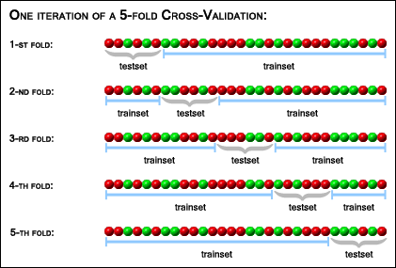

Slide 18
Confusion Matrix
Confusion matrix tells us how well our classifier has performed, wrt performance on individual classes.
It is filled up based on the test set whose true labels is known.
The test data is passed through the classifier and predictions are noted.
A table of predicted labels vs true labels is then filled out .

Slide 19
Confusion Matrix
The way you fill out the confusion matrix is simple - you check the predicted label if it matches its true label then count one on the diagonal element of the corresponding class.
If it is wrongly classified count one on the (predicted class, target class) element.
This process is repeated for all elements of the set under consideration.

Slide 20
Confusion Matrix
We need this kind.
We love Machine learning
Actual
You are cute in real life and Machine predicted it too!
You are not cute in real life but Machine insisted that you’re cute.
You are cute
You are not
True Positives
False Positives
You are cute
Predicted
False Negatives
True Negatives
You are not
We know how you feel
You are cute in real life but Machine said it otherwise.
Nasty Machine!
You are not cute in real life and Machine knew it too!

Slide 21
Performance Measures
Precision:
Precision = Number of True Positives /(No. True Positives + No. of False Positives)
A trivial way to have perfect precision is to make one single positive prediction and ensure it is correct (precision = 1/1 = 100%).
This would not be very useful since the classifier would ignore all but one positive instance.
So precision is typically used along with another metric named recall, also called sensitivity or true positive rate (TPR)

Slide 22
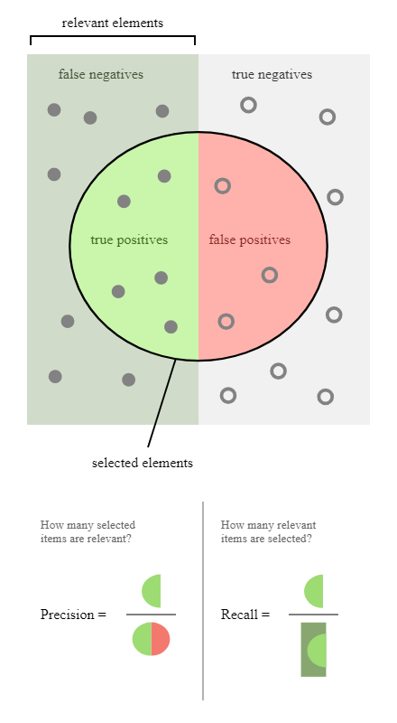
Performance Measures
Recall:
Recall = Number of True Positives / No. of True Positives + No. of False Negatives
It is often convenient to combine precision and recall into a single metric called the F1 score, in particular if you need a simple way to compare two classifiers.
The F1 score is the harmonic mean of precision and recall

Slide 23
Performance Measures
The receiver operating characteristic (ROC) curve is another common metric that is used with binary classifiers
It is very similar to the precision/recall curve, but instead of plotting precision versus recall, the ROC curve plots the true positive rate (another name for recall) against the false positive rate.
The FPR is the ratio of negative instances that are incorrectly classified as positive.
It is equal to one minus the true negative rate, which is the ratio of negative instances that are correctly classified as negative.
The TNR is also called specificity. Hence the ROC curve plots sensitivity (recall) vs 1 – specificity.

Slide 24
